Slide 1
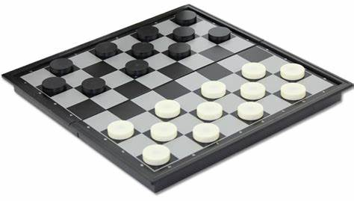
Draught
CS181 Final Project
周守琛 叶柯成 张郅睿 王鹏豪

Slide 2
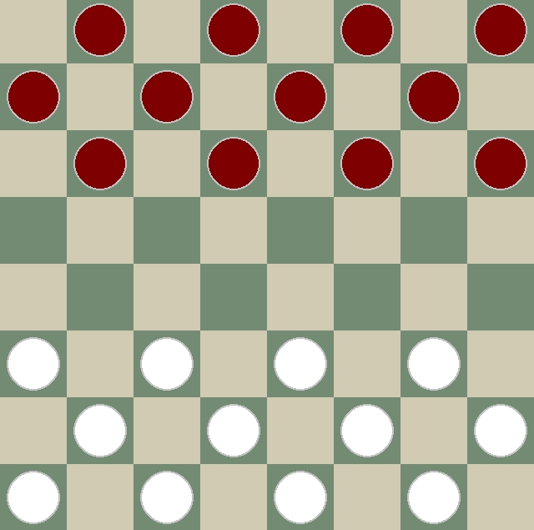
Settings
8*8 grids
24 pieces (12 per side)

Slide 3
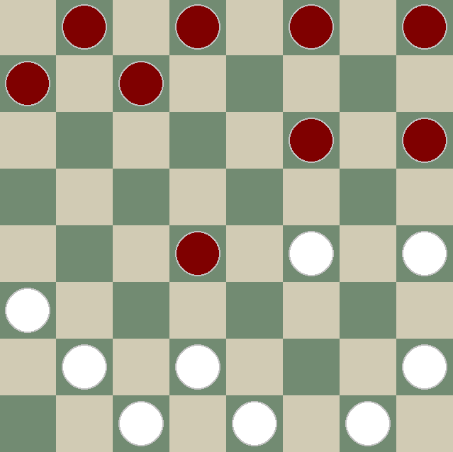
Game Rules
move forward diagonally, no retreat
jumping to eat
eat the most
reaching the bottom line and becoming king

Slide 4
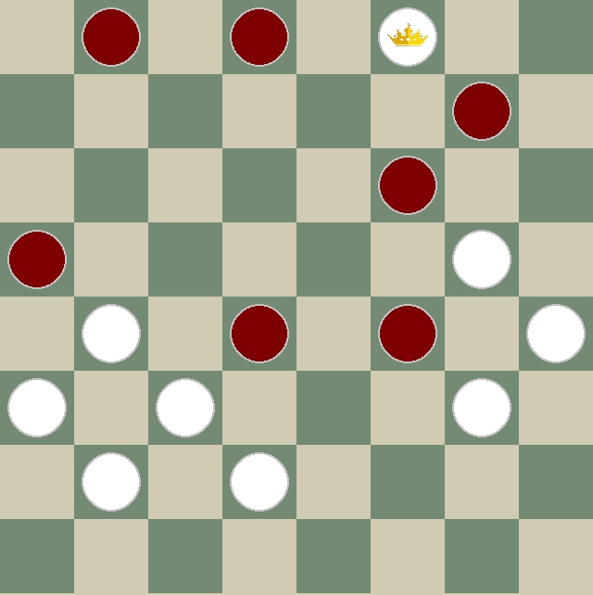
Game Rules
after becoming the king, there is no distance limitation
King can go forward and backward

Slide 5
Implement methods
Search
Adversarial search (minimax, alpha-beta pruning)
Reinforcement learning
MCTS

Slide 6
Thank you

